Slide 1


Cyber Security and Online Privacy
Staying Safe in the Digital World
PRESENTED BY :-
AYESHA NASIR
BS-MATH-80

Slide 2
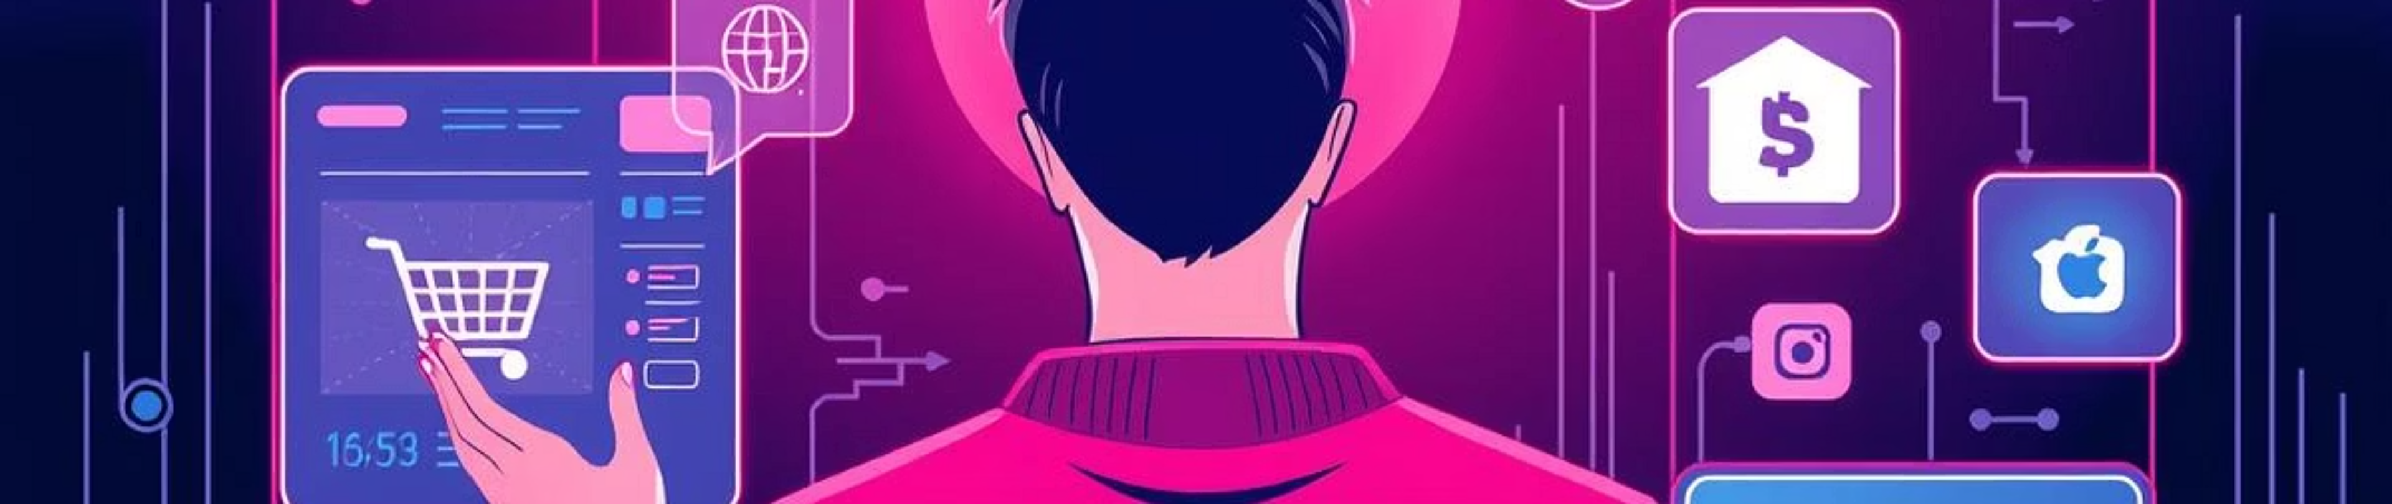
Navigating the Digital Landscape
In today's digital world, we leverage the internet for everything like shopping, banking, and social media. While these advancements offer incredible convenience and connectivity, they also introduce significant risks—primarily in the form of cyber threats. This makes understanding and practicing cyber security and online privacy absolutely vital in our daily lives.

Slide 3
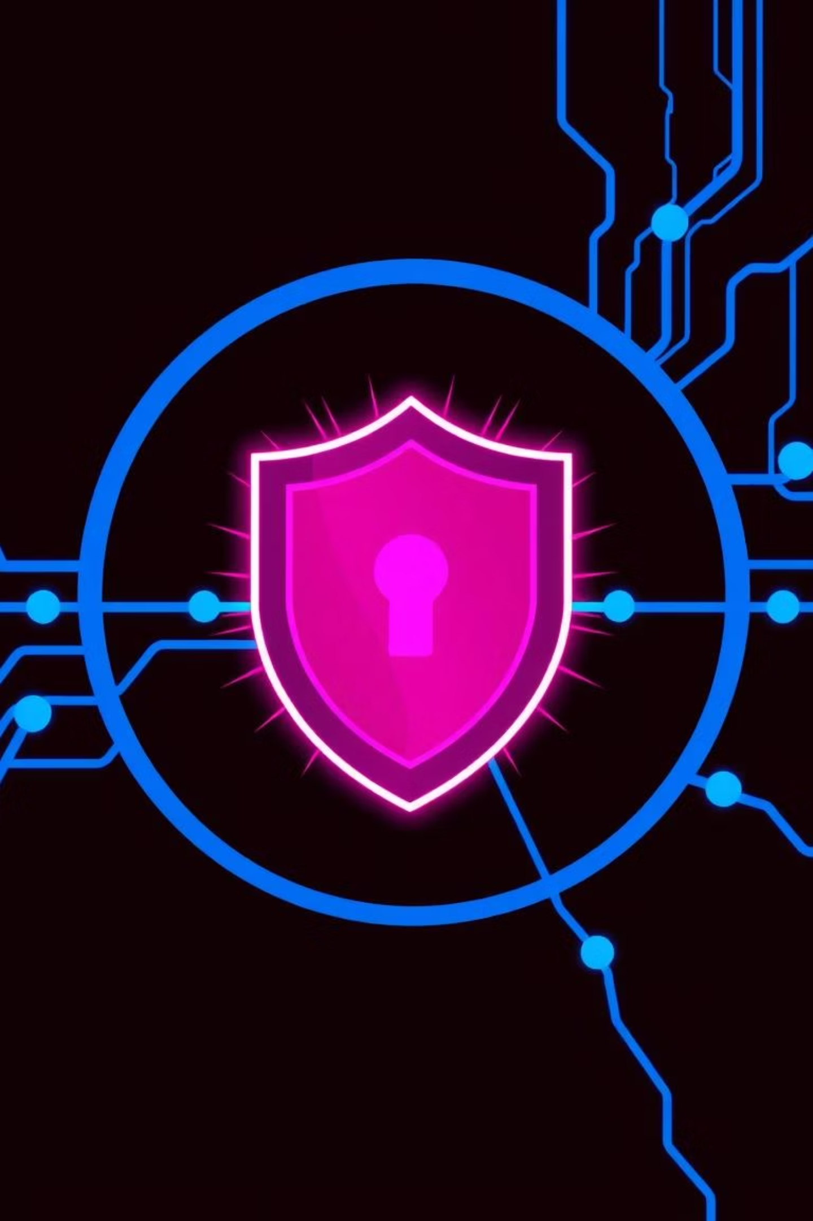
What is Cyber Security?
01
02
Digital Fortress
Threat Prevention
Cyber security is the practice of protecting computers, mobile phones, and networks from digital attacks and unauthorized access. It's like building a strong defense around your digital life.
Its primary goal is to prevent hacking, malware infections, and various cyber attacks that can compromise your devices and data.
03
Data Safeguard
Ultimately, cyber security ensures the protection of your important data and information, keeping it confidential, integral, and available only to you.

Slide 4
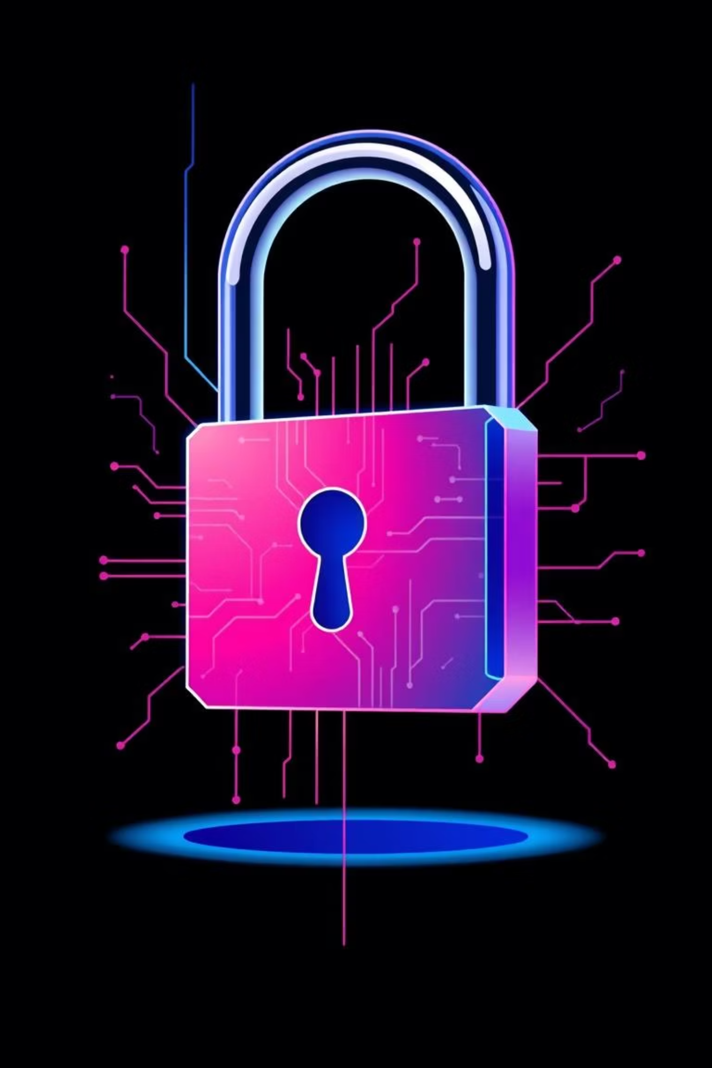
Understanding Online Privacy
Online privacy is about having control over our personal information online. It dictates who can access your data and how it's used. This includes sensitive details such as:
Your Name: Personal identification
Bank Details: Financial information
Passwords: Keys to your digital accounts
Location: Where you are in the real world
Photos: Visual records of your life
The main purpose of online privacy is to prevent the misuse of your data and identity theft, safeguarding your digital persona.

Slide 5
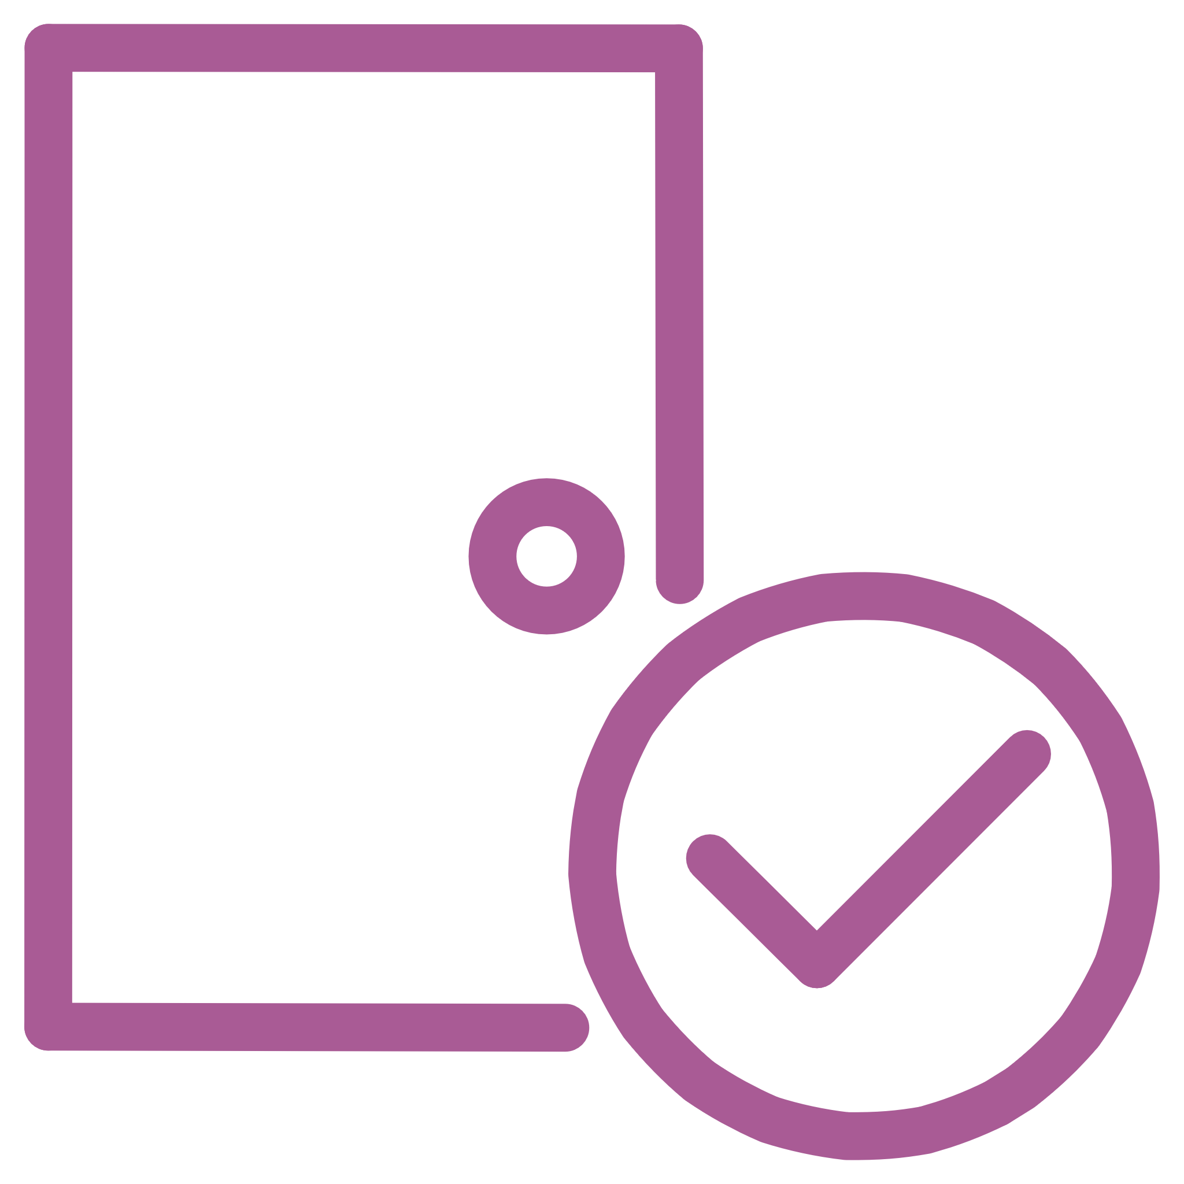


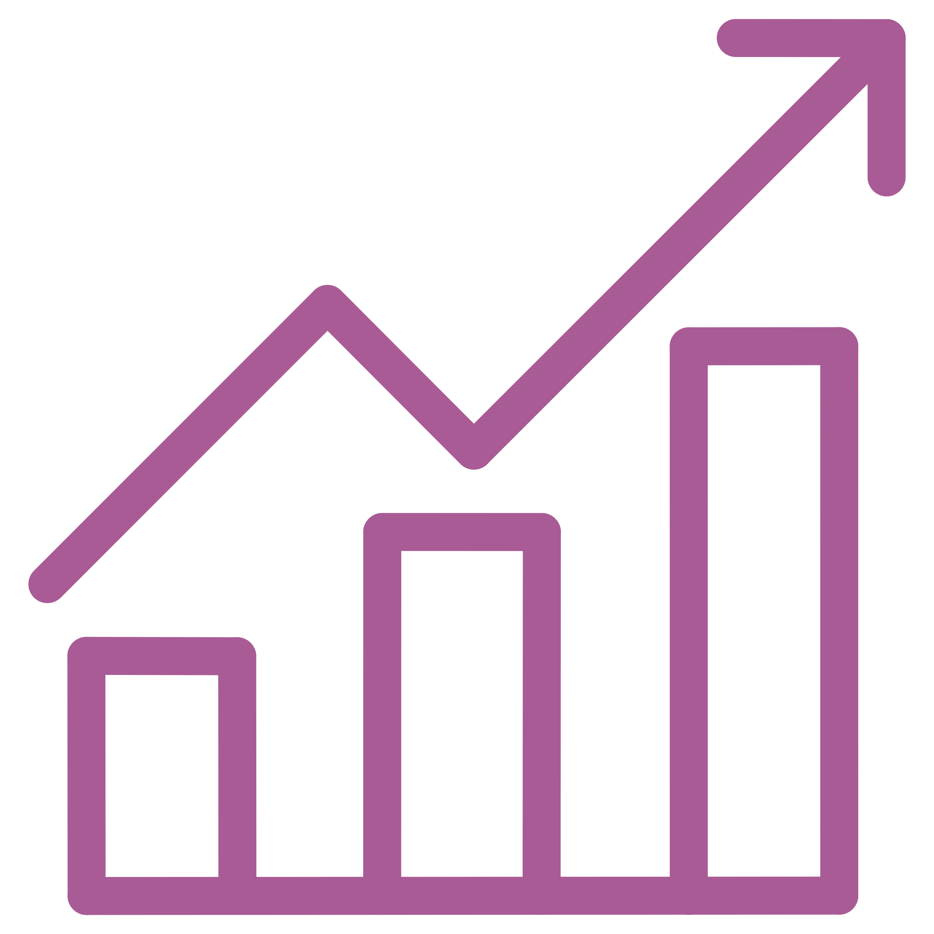
Common Cyber Threats You Should Know
Hacking
Phishing
Unauthorized access to your online accounts, devices, or systems, often leading to data theft or manipulation.
Deceptive emails or messages designed to trick you into revealing personal information, like passwords or credit card numbers.
Malware
Data Breaches
Malicious software, including viruses and ransomware, designed to damage your device or steal your data.
Incidents where sensitive, protected, or confidential data is accidentally or intentionally exposed to an unauthorized party.

Slide 6

Why Cyber Security and Privacy Are Crucial
Protects Personal & Financial Data
Safeguards your sensitive information from unauthorized access, keeping your identity and finances secure.
Prevents Online Fraud & Scams
Acts as your first line of defense against financial losses and personal distress caused by malicious actors.
Keeps Social Media Accounts Safe
Protects your digital reputation and personal interactions from being compromised or misused.
Builds Trust in Online Services
Ensures a reliable and secure environment for online transactions, communication, and digital interaction.
Secures Organizations & Countries
Extends beyond individuals to protect critical infrastructure, national security, and economic stability.

Slide 7





Simple Steps to Protect Yourself
Use Strong Passwords
Combine uppercase and lowercase letters, numbers, and symbols. Avoid easy-to-guess information.
Enable Two-Factor Authentication (2FA)
Adds an extra layer of security, requiring a second verification method beyond your password.
Do Not Click Unknown Links
Be wary of suspicious links in emails or messages; they could lead to phishing sites or malware downloads.
Avoid Sharing Personal Information
Think twice before sharing sensitive details online, especially on public platforms or with unverified sources.
Update Software & Antivirus Regularly
Keep your operating system, applications, and antivirus software up-to-date to patch vulnerabilities.

Slide 8
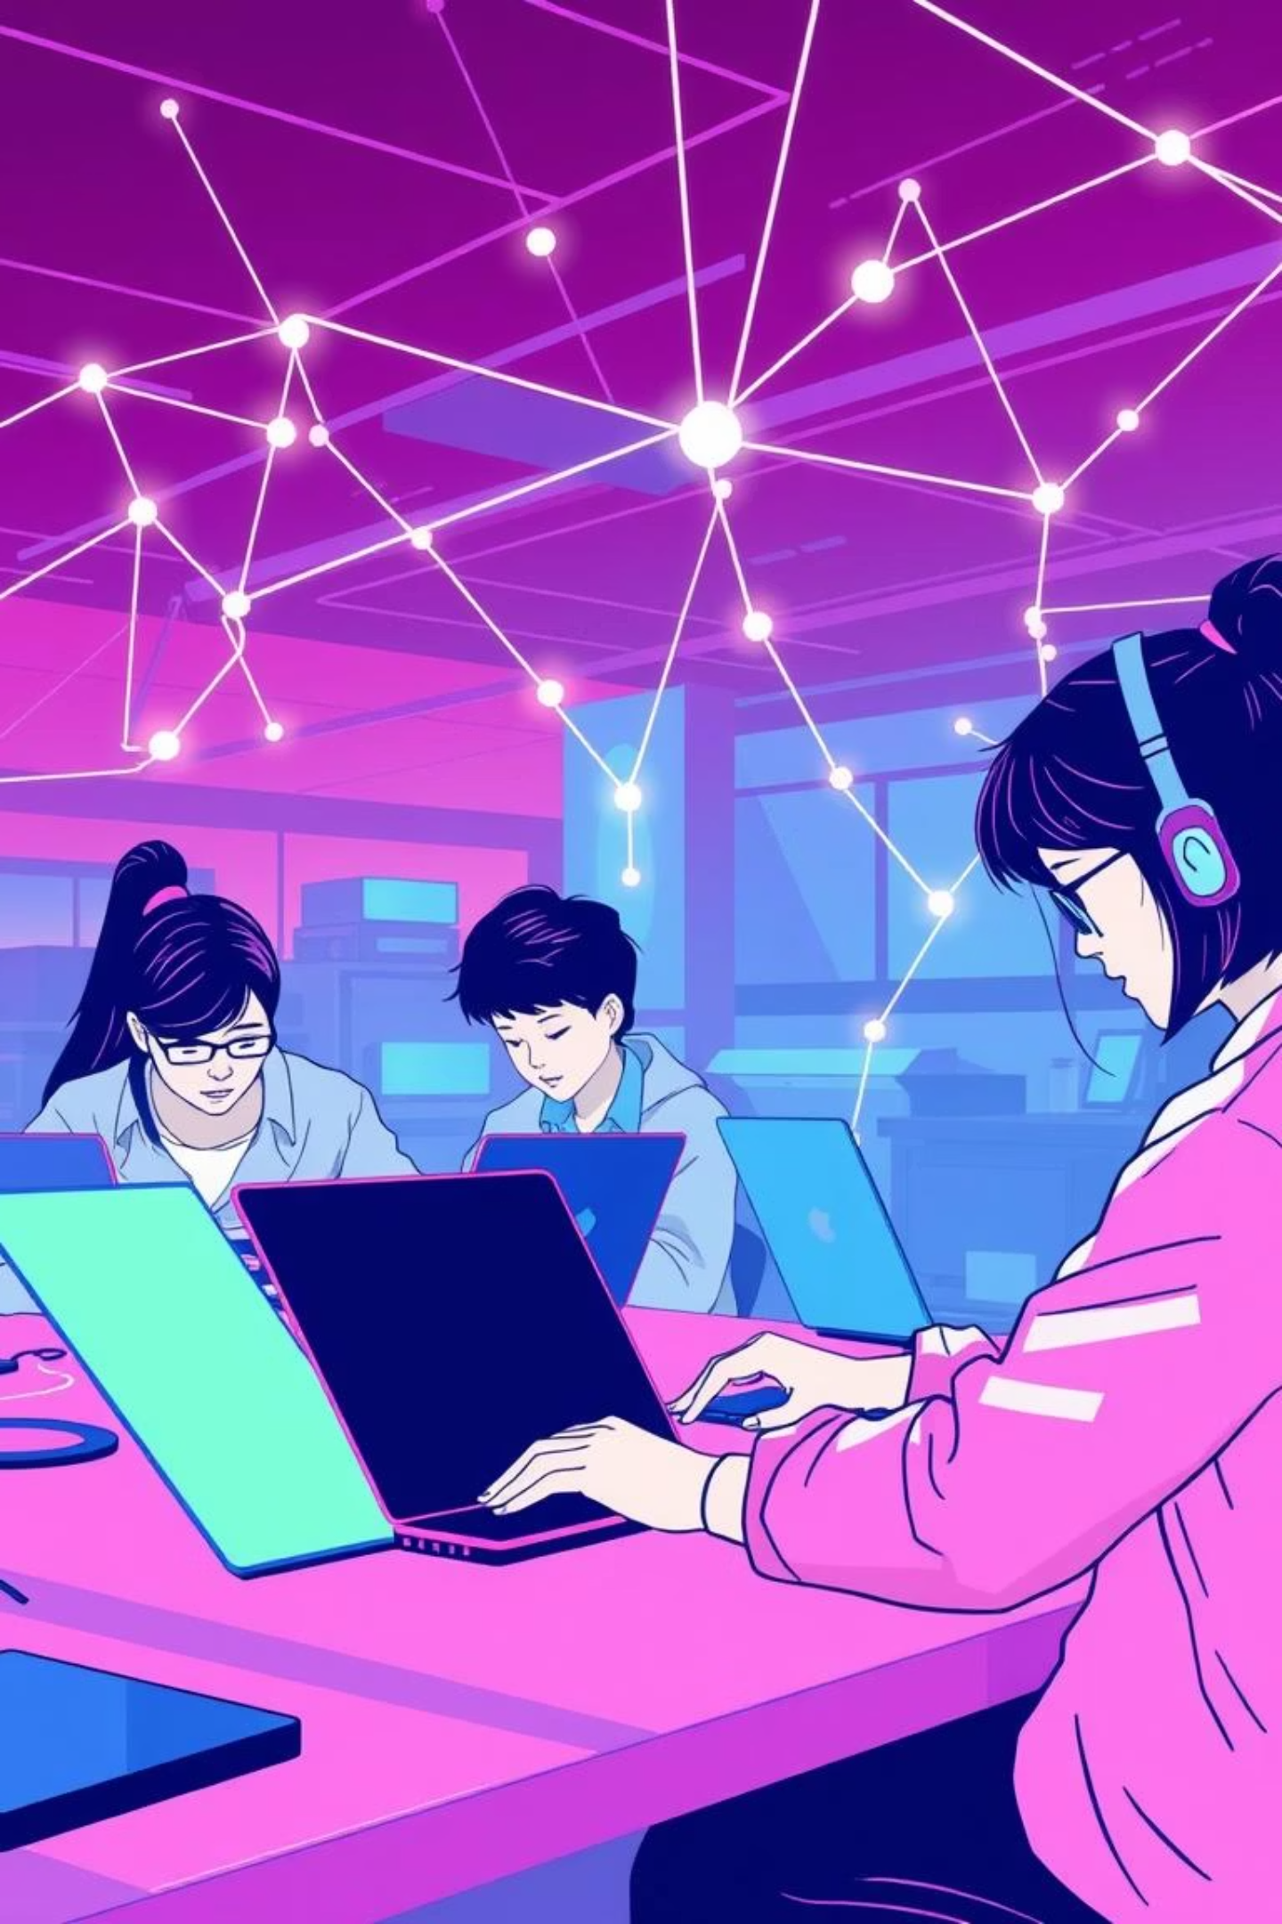
Your Role as a Student in Digital Safety
Be a Responsible Internet User
Learn Basic Cyber Safety Rules
Understand the impact of your online actions and choose to interact ethically and safely.
Familiarize yourself with fundamental practices to protect your data and privacy.
Spread Awareness Among Peers
Share your knowledge and encourage friends and family to adopt secure online habits.

Slide 9

The Path to a Secure Digital Future
Cyber security and online privacy are not only technical issues but personal responsibilities. By using the internet wisely and safely, we can create a secure digital future.

Slide 10

Thank You!
Questions?

